Slide 1



Planning Socio-Emotional Response Generation for Conversational Agents
Defended by Lorraine Vanel on July 8th
THESIS COMMITTEE
Reviewers | Magalie Ochs ……………………………………………………… Professor at Aix Marseille Université
 | Lina Maria Rojas Barahona…………………………. Senior Research Scientist at Orange
Examiners | Fabrice Lefèvre ………………………………………………….. Professor at Avignon Université
 | Jonathan Gratch ……………………………………………… Professor at University of Southern California
PhD Direction | Chloé Clavel ………………………………………………………… PhD Director, Senior Researcher at Inria Paris
 | Alya Yacoubi ……………………………………………………….. PhD Co-Supervisor, Zaion Lab

Slide 2

Research Situation - CIFRE
Planning Socio-Emotional Response Generation for Conversational Agents
INDUSTRIAL PARTNER
ACADEMIC PARTNERS
Co-Supervisor: Alya Yacoubi, PhD
Director: prof. Chloé Clavel
French Company specialised in the development of phone-based solutions for customer service and call centers.
Engineering school, member of the Institut Polytechnique de Paris
Laboratory: LTCI
Institut national de recherche en informatique et en automatique, French public research institute. Laboratory: Almanach

Slide 3
Current Industrial Conversational Systems
Planning Socio-Emotional Response Generation for Conversational Agents
End-to-end approaches [Kim et al., 2023] provides no visibility or control over the socio-emotional strategy underlying the response. This raises the question of industrial viability, as we become unable to control the agent’s potential errors, biases and misconceptions.
Natural Language Understanding
Dialogue Tree
Dialogue History
/
Prompt
Intent Classification
Condition A
GENERATIVE MODEL
Automatically
transcribed customer utterance
input
match
GENERATED RESPONSE
Response B
Condition B
Condition B
Entity Recognition
Condition C
Notes:
The observation at the heart of this thesis is that while agents are often led to combine emotional support and problem-solving, current industrial dialogue system don't easily allow to combine task-oriented efficiency with socio-emotional consistency.
The current industry standard for virtual agents is implemented as a modular architectures to guarantee safe and consistent automated responses.
Such a process ensures the agent's behaviour falls under human control.
However, this modular design not only heavily relies on massive fully-annotated data, but also suffers from many intrinsic drawbacks, such as serious error accumulation, poor generalization ability, expensive set-up costs, A natural consequence of this, is that it’s hard to dynamically consider the user’s specific situation, especially their social and emotional situation
Now, with the rise of LLMs, new efficient alternatives become possible: agents powered by generative AI.
However, while it solves some problems such as the scalability and the personalisation, when used as is they act like a black box, which does not allow for the needed visibility and explainability, especially for the socio-emotional policy selection
Fully end-to-end approaches [kim et al., 2023] provides no visibility or control over the socio-emotional strategy underlying the response. This raises the question of industrial viability, as we become unable to control the agent’s potential errors, biases and misconceptions. This is why we have chosen to focus on approaches that provide greater visibility by adding an explicit planning stage.

Slide 4



Research Questions
Planning Socio-Emotional Response Generation for Conversational Agents
RQ.1
Socio-emotional Response Generation
RQ.2
Adequate
Datasets
RQ.3
Evaluation
Methods
Notes:
RQ.1 How to improve the socio-emotional response generation for task-oriented dialogue while meeting the industry technological requirements?
RQ.2 What data can be used to implement this approach in the specific context of French, customer service dialogue?
RQ.3 How to evaluate the general quality as well as the social and emotional consistency of a generative conversational system?

Slide 5
Our proposed Approach
Planning Socio-Emotional Response Generation for Conversational Agents
Inspired from the literature of modular architectures, we add a planning step. To capture the dynamic evolution of a user's social and emotional state, we decide to plan a sequence of multiple socio-emotional labels
Dialogue History
Dialogue History
PLANNING MODULE
GENERATIVE MODULE
GENERATIVE MODULE
Expected Socio-Emotional Labels
GENERATED RESPONSE
GENERATED RESPONSE
[Émile: Marshalling Passions in Training and Education, Gratch (2000)]
[An empathic rational dialog agent, Ochs (2007)
Notes:
Currently, LLMs are not an immediate viable option for industry, because of their lack of controllability. To leverage their high generative capabilities, we draw inspiration from the literature of modular architectures, namely planning modules.
Thus, we propose to add such a planning step preceding the generation. As we seek to capture the dynamic evolution of a user's social and emotional state, we decide to plan a sequence of multiple socio-emotional labels. These labels represent the behaviours that we expect to see in the generated response.

Slide 6


Contributions of this thesis
Planning Socio-Emotional Response Generation for Conversational Agents
Two-Module Architecture
A Novel Dataset
Evaluation Benchmark
Notes:
1. a 2-module architecture including an explicit planning step to obtain a sequence of socio-emotional label, and a generative module to influence the generation of the response accordingly
2. Few resources combine task-oriented dialogues with socio-emotional annotations, especially multi-label annotations. Thus, we curate a new Dataset tailored for the task of socio-emotional response generation and annotated on the speaker turn
3. Lastly, we compare different evaluation methods to 1. evaluate the performance of the system and 2. assess the performance of current available metrics when compared to human judgment

Slide 7

1
Approach
DATA-SERGe
Experiments
Conclusions
DATA-SERGe
Experiments
Conclusions
Approach
Notes:
To present these contributions, I will first present the general approach, then describe the creation of the dataset before analysing our experimental findings. Using these results, I will discuss our research questions and conclude.

Slide 8


Socio-Emotional Labels
While various emotion-based strategies exist, we decide to focus on emotions to study the emotional dynamics between agent and customer.
Emotions-based Strategies
Detection, processing, or expression of emotions to efficiently respond to an emotional state
Dialogue History
PLANNING MODULE
GENERATIVE MODULE
Expected Socio-Emotional Labels
GENERATED RESPONSE
Sentiment (Lu et al., 2021)
Biological emotions (Ekman, 1999, Liu et al., 2021)
Task-oriented emotional states (Feng et al., 2021)
Notes:
Research in affective computing has focused on applying the mechanisms that underlie human emotion and social action regulation and expression to conversational systems. We focus on two main strategies that have emerged to model these mechanisms.
While many emotion-based strategies exist, such as empathy, we decide to focus on emotions to study the emotional dynamics between agent and customer.
(dissastified, apologetic)
In task-oriented applications, the challenge is to generate responses that both fulfil the task and appropriately address the user’s social and emotional state., but few studies tend to combine action-focused and emotion-focused strategies

Slide 9

Socio-Emotional Labels
Amgoud et al. (2006) defines a dialogue strategy as “a two-step decision process that involves selecting the type of act to utter at a given step of a dialogue and selecting the content that will accompany the act.”
Emotion can be combined with conversational moves to generate a more natural, consistent social behaviour.
Dialogue Strategies
Dialogue/support strategies (Amgoud et al., 2006, Liu et al., 2021)
Response Intents (Welivita et al., 2021)
Dialogue Acts (Bunt, 2006, Li et al., 2017)
[An argumentation-based framework for designing dialogue strategies, Amgoud et al., 2006] [Towards Emotional Support Dialog Systems, Liu et al. (2021)]
Notes:
The term dialogue strategies is heavily inspired of the work of Liu et al 2021 on support strategies. We also looked at the work of Amgoud, that defines a dialogue strategy as a 2-step component that first selects a label, and 2. select/generate text accordingly.

Slide 10
Socio-Emotional Labels
ANGER
Rage
Exasperation
Irritation
Annoyance
Impatience
Lassitude
SURPRISE
FEAR
Panic
Stress
Confusion
Worry
Caution
SADNESS
Distress
Resignation
Disappointment
JOY
Satisfaction
Relief
Interest
DISGUST
Contempt
Mockery
Coldness
Dialogue Strategies
Disagreeing
Agreeing
Back-Chanelling
Encouraging
Sympathising
Restating
Informing
Questioning
Providing Suggestions
Self-Disclosing
Social/Politeness
Correction
Bot / Nonsense
Agression
Other
20 fine-grained emotions
15 dialogue strategies
(Ekman et al.,1999, Izard et al., 2013, Devillers and Vidrascu, 2006)
(Liu et al., 2021, Rashkin et al., 2018, Welivita et al., 2021)
Notes:
Emotion: We use scheme designed at Zaion, as it has been successfully used on customer data. It is grounded in classic theory of emotion + completed by work on call centre data
DS: we look at the literature to gather existing labels, and we fine-tune it by launching a trial annotation. This list is tailored to our data, and we believe it can be used on any task-oriented corpus

Slide 11
E2E Generation (NO-CD) VS ConDitional Generation (CD)
Context History
customer
agent
Yes. Five pm.
Ok, perfect! thank you.
Yes. Five pm.
Ok, perfect! thank you.
CD
[Information, Restating, Information, Politeness]
Satisfaction
Yes, they just told me that they were still working on your vehicle, and that it should be good to go in about an hour and a half.
“Information”, “Politeness”
?
[Information]
STEP 1: From context history, predict the labels expected in the next response
STEP 2: Using context history and the list of expected labels, generate the response
Right, so I should get there around five pm. Thank you, madam, have a nice day.
[Information, Politeness]
NO-CD
“Information”, “Politeness”
Yes, you can go there at five pm. You’re welcome, goodbye.
Have a nice day.
?
[A New Task for Predicting Emotions and Dialogue Strategies in Task-Oriented Dialogue Vanel, Yacoubi and Clavel, ACII 2023]

Slide 12
Planning Module
While many approaches to response planning exist, few studies tackle the planning of multiple socio- emotional labels for response generation, and none have modelled this problem as a sequence prediction task.
We propose an architecture comparable to [Yang et al. (2021)], but we plan a sequence of dialogue strategies to enhance the quality of generated responses.
Context History
Yes. Five pm.
Ok, perfect, thank you.
[Information, Restating, Information, Joy, Politeness]
Yes, they just told me that they were still working on your vehicle, and that it should be good to go in about an hour and a half.
Multi-label Classification (BERT)
[Information]
STEP 1: From context history, predict the labels expected in the next response
Right, so I should get there around five pm. Thank you, madam, have a nice day.
Fine-tuned Sequence Generation (BART)
[Information, Politeness]
?
Prompt-based Sequence Generation (Llama)
[Towards Emotional Support Dialog Systems, Liu et al. (2021)]
Notes:
While many approaches to response planning exist, few studies tackle the planning of multiple social and/or emotional actions for response generation, and none have modelled this problem as a sequence prediction task.
We propose an architecture comparable to yang et al's work on emotional support dialog systems, which integrates a planning step followed by a conditional generation step. We propose to improve the planning phase by planning a sequence of conversational strategies to enhance the quality of generated responses.
Graph (the inability to scale is a major drawback of graph-based modules.), Rl but especially RL that requires Human or Simulated Human Feedback (RLHF), is a complex, often unstable and usually very costly procedure.

Slide 13
Planning Module: Evaluation Protocol
REFERENCE-BASED
Multi-label prediction metrics
Similarity metrics
Other metrics
F1 Score
Jaccard Similarity
Mean length of label sequences
Precision
Normalised Levenshtein Similarity
Recall
scikit-learn library
textdistance library
Ground truth labels
Output of the planning module
“Information”, “Question”, “Politeness”
3 labels
“Information”, “Politeness”
2 labels
Notes:
Only automatic and reference based
To round up the analysis, we look at the mean length between ground truth and output of planning to study the general behaviour of the system.

Slide 14
Generative Module
The absence of multi-label approaches is also observed in the literature of conditional generation.
We tested multiple approaches, such as traditional generation using BART or dialoGPT, but we mainly focused on prompt-based generation.
Context History
Yes. Five pm.
Ok, perfect! thank you.
[Information, Restating, Information, Joy, Politeness]
Prompt-based
Automatic template filling to include:
Context of the interaction
Dialogue history
Sequence of expected labels
Yes, they just told me that they were still working on your vehicle, and that it should be good to go in about an hour and a half.
Here is an excerpt from a phone call between an auto repair agent and a customer:
[CONTEXT]
From the dialogue extract and the following response plan, generate the agent's answer:
1. Label 1
2. Label 2
The answer should be short and clear, while maintaining the oral tone of a telephone conversation.
AGENT:
“Information”, “Politeness”
?
[Information]
Right, so I should get there around five pm. Thank you, madam, have a nice day.
STEP 2: Using context history and the list of expected labels, generate the response
[Information, Politeness]
?
[Controllable mixed-initiative dialogue generation through prompting, Chen et al. (2023)]
Notes:
The absence of multi-label approaches is also observed in conditional generation. We tested multiple approaches, such as traditional generation using BART or dialoGPT; but we mainly focused on prompt-based generation.
While none of the studies on prompt-based LLMs are adapted for multi-label generation, the high performance of LLMs has been proven repeatedly by a large amount of recent research. We decided to capitalise on the strong generative capabilities of these models to design a template, completed by the dialogue history and the planned dialogue strategies sequence, to condition the generation of the response.

Slide 15
Generative Module: Response Evaluation
REFERENCE-BASED
REFERENCE-FREE
BERT_context ↑ (BERTscore to compare the similarity between the context and the response.)
Perplexity (PPL) ↓ (Jelinek et al., 1977)
WORD OVERLAP
SacreBLEU ↑ (Post, 2018)
ROUGE ↑ (Lin, 2004)
CHRF ↑ (Popovi´c, 2015)
METEOR ↑ (Banerjee and Lavie, 2005)
EMBEDDING-BASED
BERTscore ↑ (Zhang et al., 2020)
CORPUS LEVEL
Semantic Diversity ↑ (Guo et al., 2024)
Lexical Diversity ↑ (Guo et al., 2024)
Intra-Strategy BERT-score ↑ (pair-wise comparison of the segments carrying the same strategy)
FINE-TUNED CLASSIFIERS
Emotion F1 ↑ (F1 score accounts for unbalanced classes.)
Dialogue Strategy Similarity ↑ (Jaccard & Levenshtein Similarity between the predicted sequence and GT)
Notes:
however, there is never only one good response to a dialogue, so comparing with the ground truth can sometimes be very restrictive and create a bias in the results. That's why we also consider some reference-free metrics.

Slide 16



Human Evaluation Protocol
The multiple steps allowed us to only annotate the best responses on the finer-grained criteria.
STEP 1: consistent responses filtering, irrelevant responses elimination
STEP 2: top-3 best response selection
STEP 3: socio-emotional criteria annotation
[Socio-Emotional Response Generation: A Human Evaluation Protocol for LLM-Based Conversational Systems ,
Vanel, Ramos Vela, Yacoubi and Clavel, AHRI 2024]
Notes:
The goal was to obtain an assessment of socio-emotional quality of responses, but as we tested various models, it would have taken a very long time to individually rate all responses. That is why we split the process into three steps
1. Given a context, 2 annotators look at all candidate response from evaluated systems. They will then eliminate the responses that are not consistent - do not make sense to the context - and save those that do
2. Then, they will look at the saved responses to select and rank the best 3
3. Finally, we sample some of the best responses to annotate them individually on finer-grained socio-emotional criteria

Slide 17
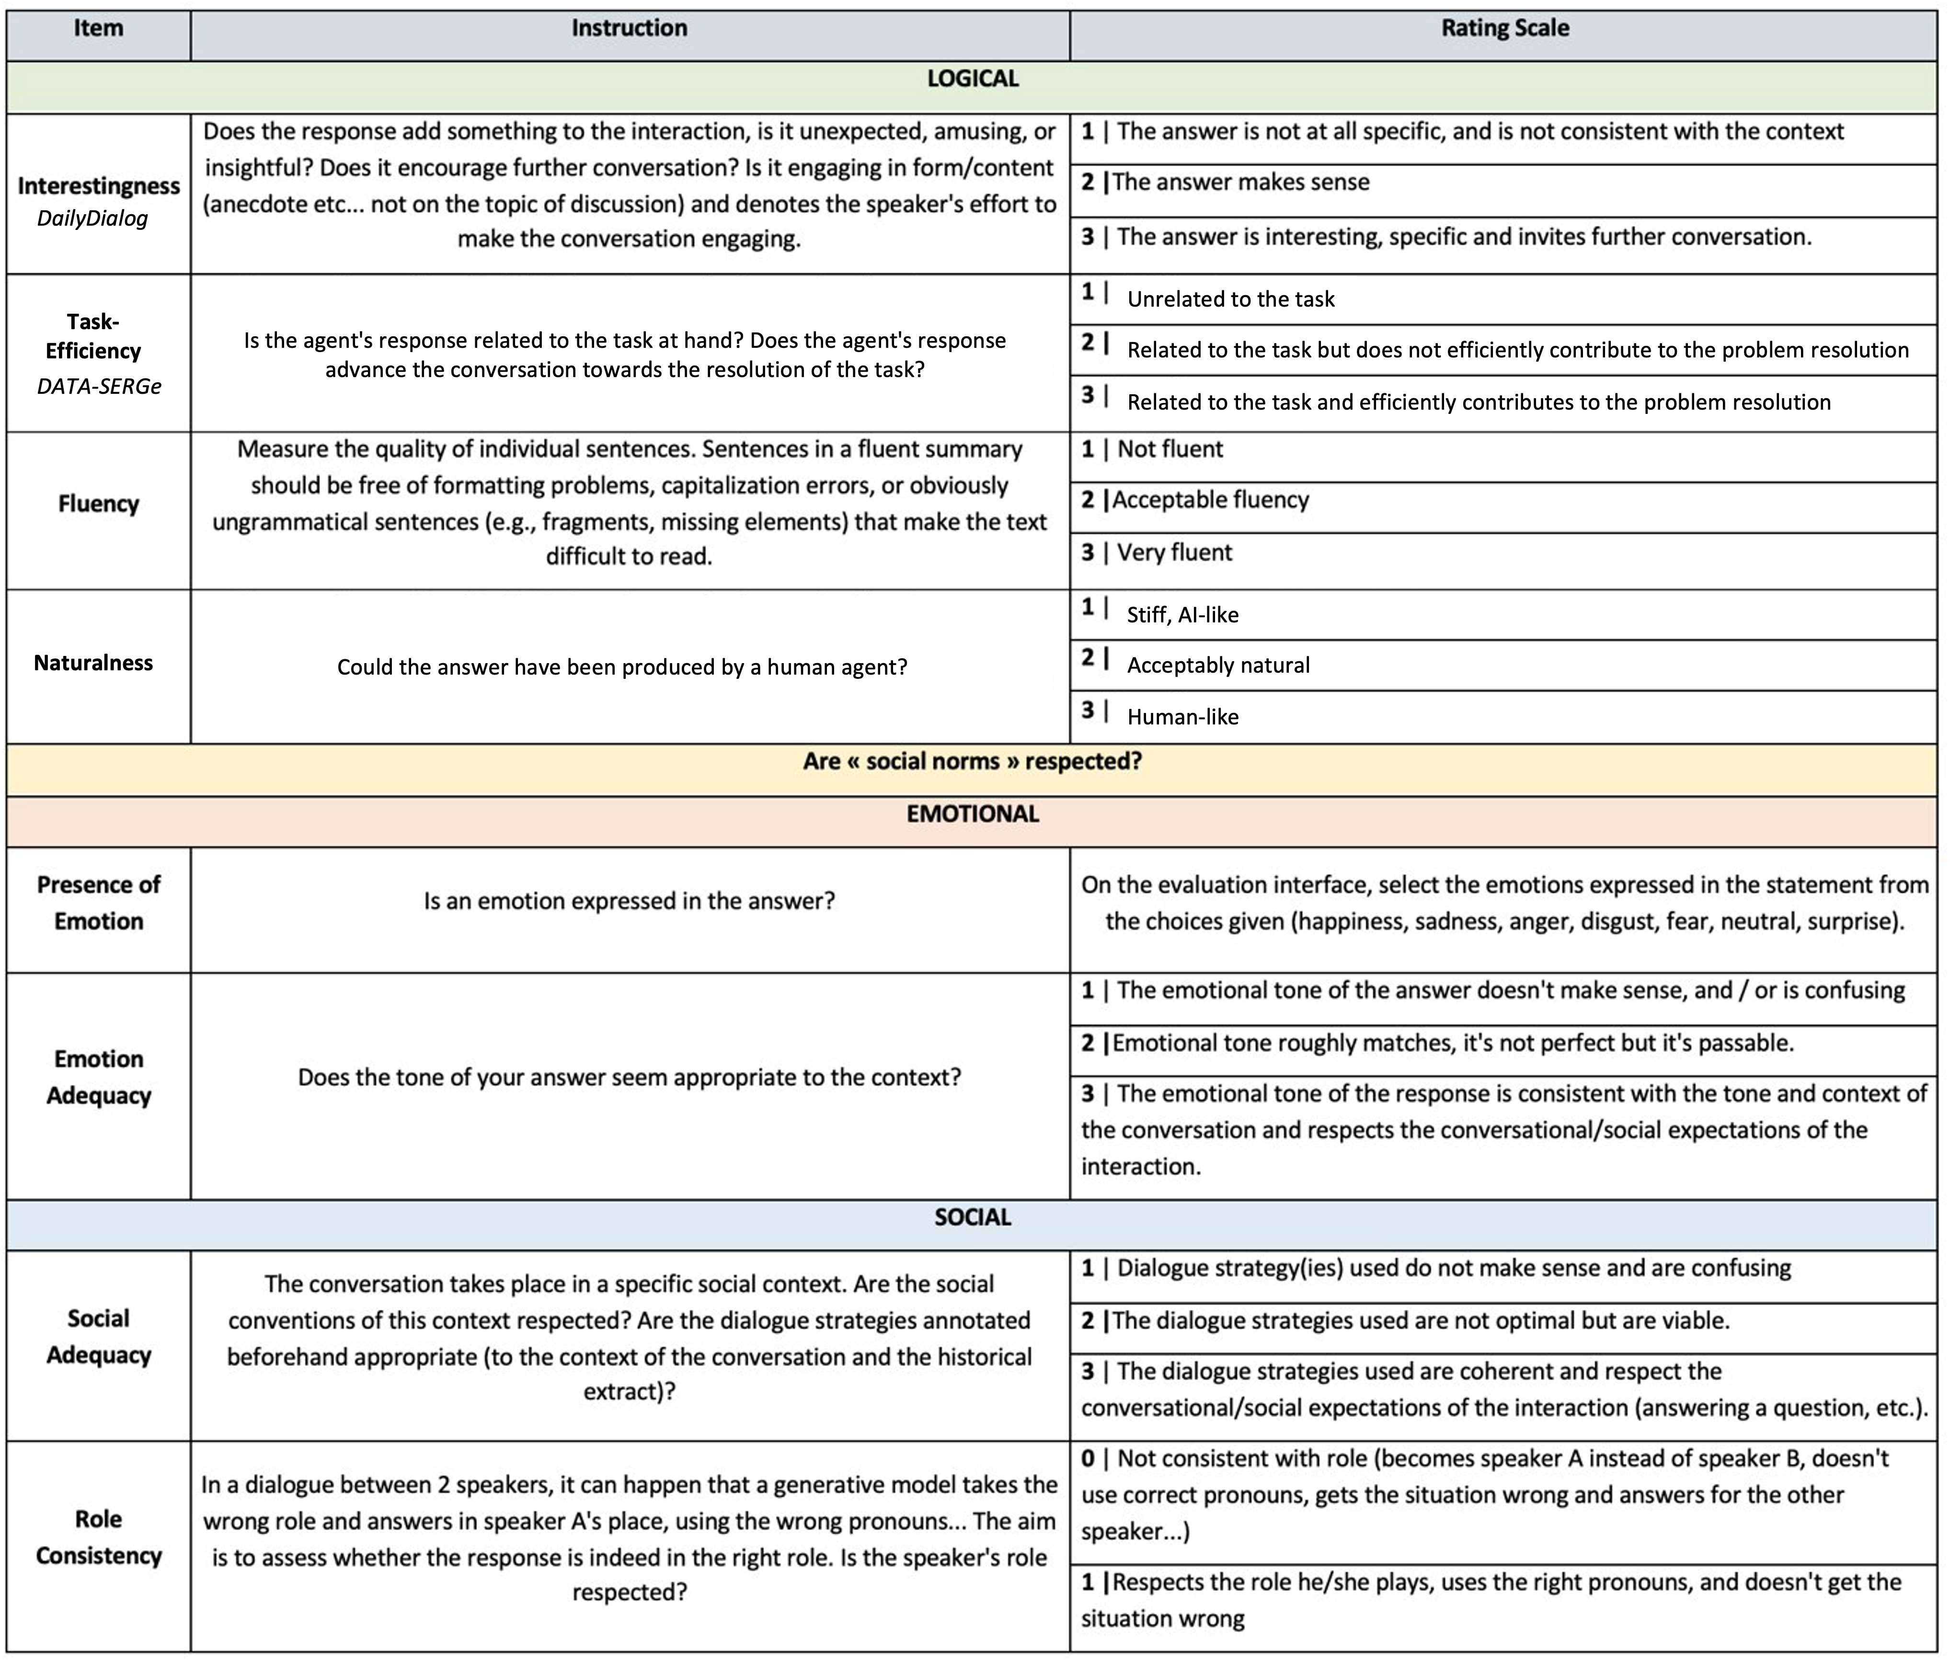
Human Evaluation: Instructions (Step 3)
We studied the literature ([Thoppilan et al. (2022), Rashkin et al., 2018])
to identify relevant items that correspond to what we seek to evaluate.
The rating scale was designed along with the annotators to optimise the time-quality ratio.
Notes:
These criteria are divided into 3 axes:
Logical consistency: fluency, naturalness
Emotional consistency: is the emotional tone adequate?
Social consistency: does the response follow the social norms of the exchange?
To create this scheme, we followed works such as those condicted on Google's LAMDA to select the items. For the rating scale, we tried a couple options (5-point scale...) and this was the scale that allowed for the best time-quality ratio.

Slide 18
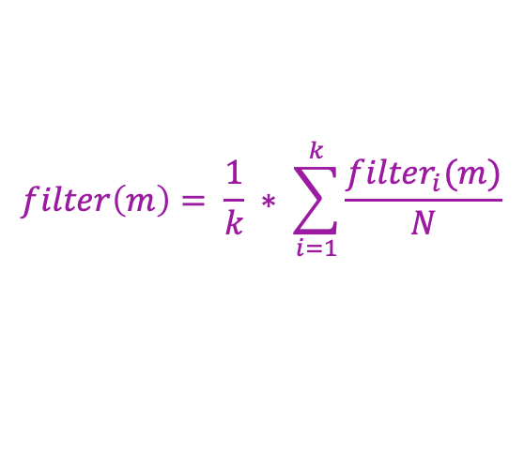
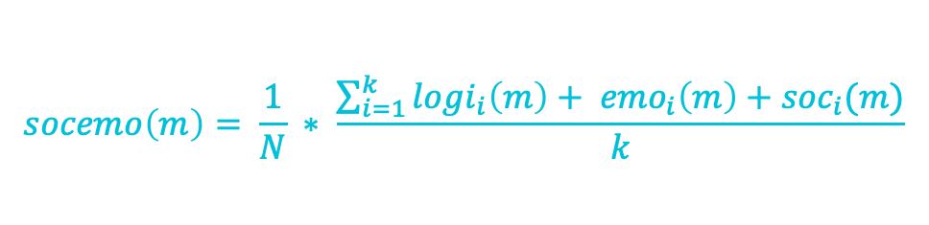
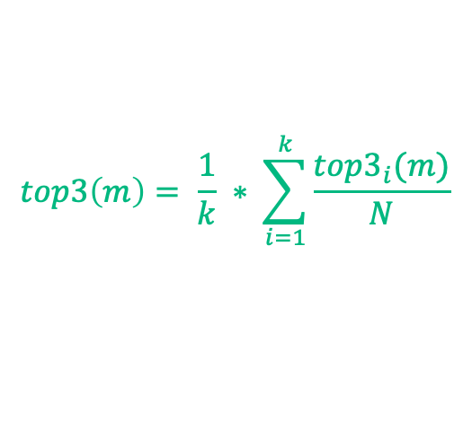
Human Evaluation: Scores
m is the considered model
K the number of annotators
N the number of samples
i the annotator
$$filter\left(m\right)= \frac{1}{k} ∗ \sum_{i=1}^{k}{\frac{{filter}_{i}(m)}{N}}$$
STEP 1
$$top3\left(m\right)= \frac{1}{k} ∗ \sum_{i=1}^{k}{\frac{{top3}_{i}(m)}{N}}$$
STEP 2
STEP 3
$$socemo\left(m\right)= \frac{1}{N} ∗ \frac{\sum_{i=1}^{k}{{logi}_{i}\left(m\right)+ {emo}_{i}\left(m\right)+{soc}_{i}(m)}}{k}$$
logi_{i}(m), emo_{i}(m) and soc_{i}(m) the logical consistency score, an emotional consistency score and a social consistency score annotated by the annotator i for the model m
Notes:
After gathering the annotations on each step of the evaluation process, we compute various metrics to analyse the results.
(Step 1) Filter i(m) computes the probability for the response of model m to be filtered as ”consistent”.
(Step 2) Similarly, top3 represents how likely the response of model m is to be chosen as part of a top-3
(Step 3) To compute these axes scores, we take the rating of each question of the category, normalise them, and calculate the mean score.
We average the logical, social and emotional consistency scores to obtain a single, more global consistency score that evaluates the quality of the response to the logical, emotional and social context of the interaction.

Slide 19
2
Approach
DATA-SERGe
Experiments
Conclusions
DATA-SERGe
Notes:
To implement this approach as faithfully as possible, we need data that meet 2 main criteria:
* Task-oriented dialogues, better if it's in French.
* Multi-label annotation in emotions and/or dialogue strategies on the speaker turn
As no readily available corpus seem to meet these needs, we curate our own: DATA-SERGe, a dataset for socio-emotional response generation.

Slide 20

DATA-SERGe A DATAset for Socio-Emotional Response Generation
DATA
67 H-H phone
conversations
in French manually transcribed into text
Task-oriented dialogue, specifically in a customer service setting (car insurance and repair)
Manually annotated by a team of 5 expert linguists and conversational analysts
PROCESSING
ANONYMISATION
To remove all personal information without impacting the structure of the dialogue.
CLEANING
To correct elements that impeded the fluidity, understanding and written conversation flow.
ORIGINAL
PROCESSED
‎ ▇▇ bonjour ▇▇ à votre écoute ?
oui bonjour madame j’ai je j- j’ai un problème avec ma- avec mon assurance
RépareCar bonjour Nadeige à votre écoute ?
oui bonjour madame j’ai je j- j’ai un problème avec ma- avec mon assurance
[COMPANY] bonjour [AGENT NAME] à votre écoute ?
oui bonjour madame j’ai je j- j’ai un problème avec ma- avec mon assurance
[COMPANY] bonjour [AGENT NAME] à votre écoute ?
oui bonjour madame j’ai un problème avec ma- avec mon assurance
Notes:
First, annotators are tasked to replace confidential information, preemptively masked by a BART model fine-tuned on customer data, by replacing them with fictional placeholder
-> agent's name always becomes Nadeige for example.
-> They record these equivalences in an excel that allowed me to create another version of the corpus, by replacing the placeholders by specific masks (nedeige becomes [AGENT NAME]
Jointly, they were asked to clean the data. We are aware this induced a loss of authenticity, namely by removing some heavy hesitations and reformulating certain sentences, but we decided it was an acceptable compromise to obtain a dataset that is more easily usable for both written and oral systems

Slide 21
DATA-SERGe A DATAset for Socio-Emotional Response Generation
DATA
67 H-H phone
conversations
in French manually transcribed into text
Task-oriented dialogue, specifically in a customer service setting (car insurance and repair)
Manually annotated by a team of 5 expert linguists and conversational analysts
PROCESSING
ANONYMISATION
To remove all personal information without impacting the structure of the dialogue.
CLEANING
To correct elements that impeded the fluidity, understanding and written conversation flow.
SPEAKER TURN LEVEL (AGENT and CLIENT)
CONVERSATION LEVEL
ANNOTATION
20 fine-grained emotion labels
15 dialogue strategies
User Satisfaction
Yes. Five pm.
Ok, perfect! thank you.
Yes. Five pm.
Ok, perfect! thank you.
Yes. Five pm.
Ok, perfect! thank you.
Satisfaction
Agent Support Quality
I, R, I, P
Problem Resolution Status
Notes:
1. First they label the emotions
2. They enturely tag the speaker turns using codes to represent the dialogue strategies
On the conversation level, we designed three indicators to evaluate the overall quality of the conversation. We did not get to exploit them very much in this project, but we did use them in work unrelated to this thesis. It contributes to the richness of this corpus on a task-oriented standpoint and we believe it might help other studies and even play a role in future avenues of this project.

Slide 22
DATA-SERGe: Annotation
CALIBRATION PHASE
The objective of this phase was to introduce the annotators to the labelling tasks. The five annotators each evaluated the randomly selected samples on each task Inter-annotator Agreement: alpha de Krippendorff of 0,674.
FULL ANNOTATION
After controlling the agreement measure, we ran the annotation process on the 67 remaining samples.
Notes:
We sampled 5 conversations so that the annotators could all perform all annotation tasks (emotion, DS, conversation indicators). This step was meant to curb the biases that come with evaluating such a subjective task. They were thus encouraged to debate and help each other, as well as create reference materials
-> interannotator agreement
-> rest of the annotation

Slide 23
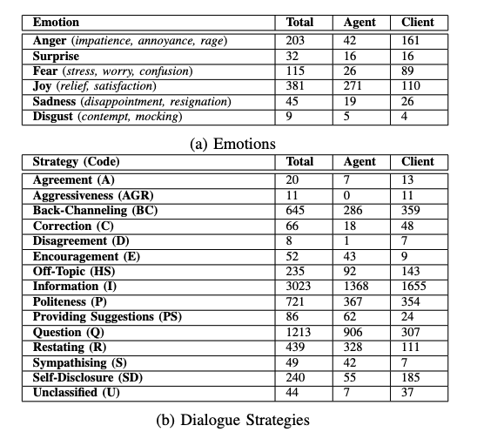
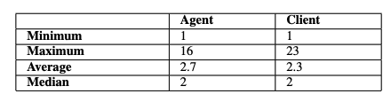
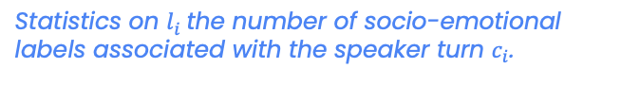
DATA-SERGe: Analysis
Number of labels annotated per emotion and dialogue strategy.
67 conversations 3051 utterances 109 841 tokens
Statistics on $l_{i}$the number of socio-emotional labels associated with the speaker turn $c_{i}$.
Notes:
Mean length of a speaker turn: 29 tokens
Average sequence of labels length: 2.5, with a median of 2 ->
validates our multi-label approach. Agents also seem to produce longer turns that are on average richer in strategies. As many strategies are used in succession, reproducing an agent's behaviour implies understanding and expressing such a sequence from the bot.
We map the fine-grained emotions onto primary emotions to clarify the analysis. For emotions, satisfaction is the main emotion overall and in the agent's turns, while for customers it is anger (annoyance). Oppositely, some emotions such as disgust, are rarely observed.
For dialogue strategies, information and questions are overwhelmingly dominant. This makes sense, as a customer service dialogue usually follows a script, and the agent must guide the customer through a sequence of Q&A. This observation is also confirmed by a study on adjacency pairs.
However, some other strategies, such as back-channeling or self-disclosure are also often used.

Slide 24

3
Approach
DATA-SERGe
Experiments
Conclusions
Experiments
Notes:
To test this architecture, we condicted multiple experiments. I will now be describing the results obtained on our last experiment that focused on improving conditional generation on DATA-SERGe.

Slide 25

Experimental Setting
DATA-SERGe
CONDITIONING SCHEMES
5 turns as context: 213 test samples (context +response)
End-to-End: direct prompt to generate the response based on the dialogue history
Conditioning on ground truth sequence of labels
1-Step Generation
Focus on prompt-based LLMs
Qwen 2.5-7B
Mixtral-8×7B
LLaMA 3-8B
2-Step Generation:
Create a response plan from label sequence + history
Generate the response using this response plan
3-Step Generation : 2-Step scheme + an additional prompt to adjust style and shorten the response
[Planning Like Human: A Dual-process Framework for Dialogue Planning, He et al. (2024)]
Notes:
We test the conditional generation module on DATA-SERGe. We select 5 turns as dialogue history.
As a reminder: DATA-SERGe is a textual dataset that was transcribed from phone conversations. Our goal here is to generate responses that match this oral style and could be converted to speech
We focus on prompt-based LLMs and compare multiple prompting strategies:
e2e -> no conditioning
conditioning on GT -> 1-, 2-, 3- step generation
2- and 3-step came from the hypothesis that asking a LLM to plan its own response would improve both the quality of the generated content and the generalisability of the approach

Slide 26
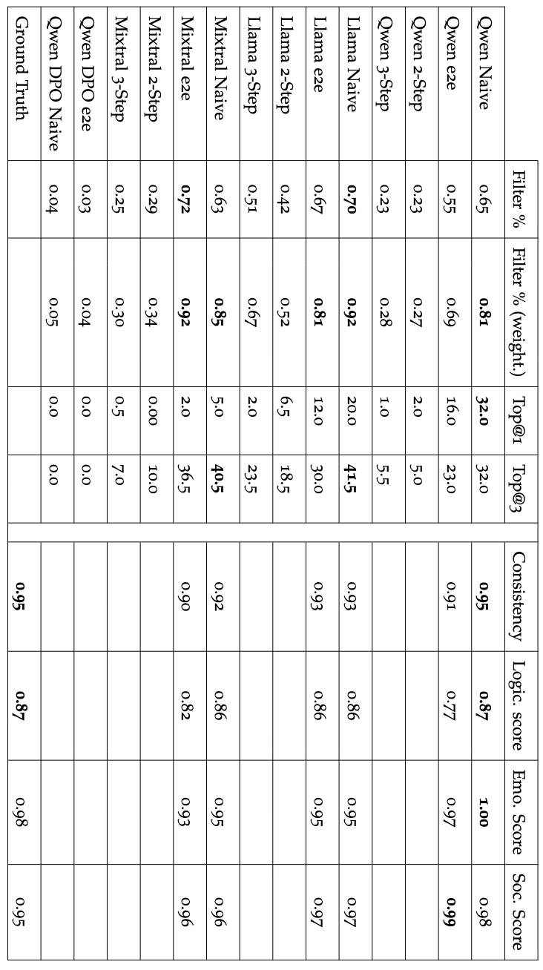
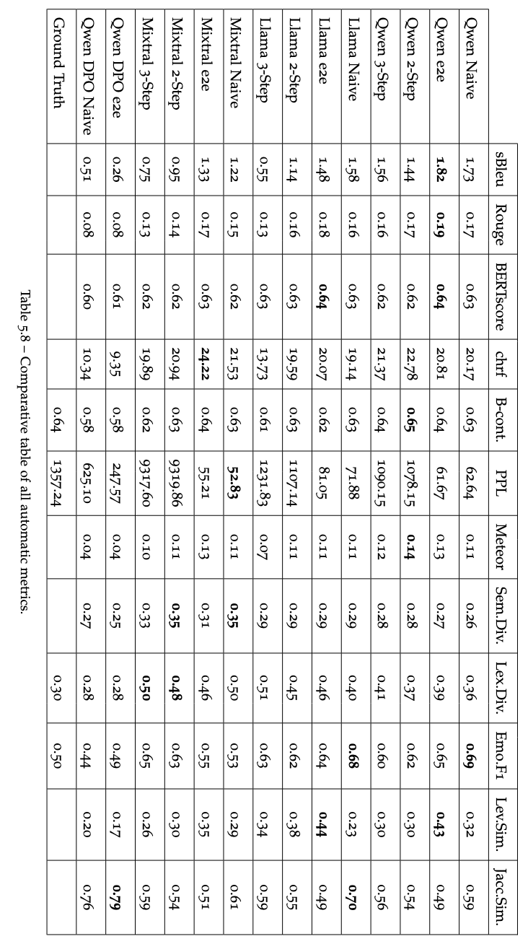
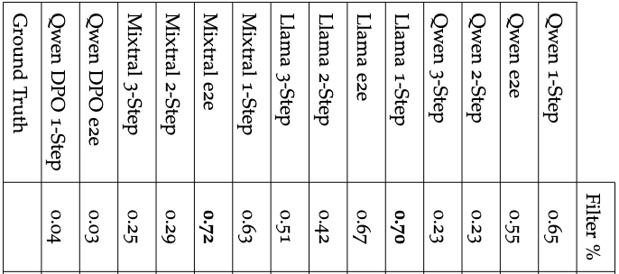
Results
HUMAN EVALUATION
100 contexts
120 responses (20 each e2e & 1-step + GT)
213 samples (full test set)
Both the filtering and ranking phases shows that 1-step and e2e generation are preferred in direct comparison to the others
FILTER
TOP3
SOCEMO ANNOTATION
AUTOMATIC METRICS
Socemo
The preference for the 1-step schemes seems to yield two conclusions:
CONDITIONING SCHEMES
End-to-End: direct prompt to generate the response based on the dialogue history
While Llama 1-step and Mixtral 1-step have the best Top@3, Top@1 shows that Qwen 1-step, when selected in the top-3, was always ranked first.
1. The selection of 1-step over end-to-end shows that planning does have a positive impact on the quality of the response
1-Step Generation:
Conditioning on ground truth sequence of labels
2-Step Generation:
Create a response plan from label sequence + history
Generate the response using this response plan
Overall, Qwen 1-step seems to be the preferred model, as it shows a general socio-emotional (SocEmo) and Logical scores on par with human responses and even outperforms the ground truth on the emotional and Social scores.
2. The poor performance of multi-step generation imply that despite their superior generative capabilities, LLMs struggle to achieve good results on planning tasks.
3-Step Generation : 2-Step scheme + an additional prompt to adjust style and shorten the response
Notes:
The results disprove that hypothesis, by having the 1-step and the e2e generation far outperform the multi-step generation.
Both the filtering and ranking phases shows that these models are often selected above the others. Llama and Mixtral models, as well as Qwen 1-step, have equivalent results, with a slight preference for Mixtral models. However, Mixtral is also the model that generates sentences in English the most often, which is a definite concern and explains a proportion of the times Mixtral responses were not selected. Furthermore, while Llama 1-step and Mixtral 1-step have the best Top@3, Top@1 shows that Qwen 1-step, when selected in the top-3, was always ranked first, which makes it a better option. Similarly, we see that even though Llama 1-step and Mixtral 1-step have similar Top@3, Llama 1-step has been preferred, as its Top@1 is better than Mixtral’s.
For the second step of the human evaluation, we set aside the models that performed poorly in the previous two steps, thereby retaining the end-to-end and 1-step planning options.
Overall, Qwen 1-step seems to be the preferred model, as it shows a general socio-emotional (SocEmo) and Logical scores on par with human responses and even outperforms the ground truth on the emotional and Social scores. Generally, the preference for the 1-step schemes seems to yield two conclusions: the selection of 1-step over end-to-end shows that planning does have a positive impact on the quality of the response, and the poor performance of multi-step planning imply that despite their superior generative capabilities, LLMs struggle to achieve good results on planning tasks.
Comparing automatic metrics, we see that while the general agrees on the superiority of e2e and1-step, they tend to prefer e2e. Our correlation study between human and auto metrics further highlights the discrepancy between both sets and the inability of current metrics to echo human judgement@

Slide 27
Annotators’ Qualitative feedback
Observation | Example
Style
Overly formal sentences, including abusive and lengthy reformulations of the entire exchange (more common in written conversation) | "Of course, I understand that certain letters such as double H's and G's can be difficult to pronounce and cover in our car insurance. For these particular cases, we have to invoice outside our insurance. To clarify, can you tell me what types of vehicles or specific situations with these letters concern you most? This will help us determine the best possible cover for your needs."
Uses "I", instead of speaking as a representative of a business | "If you have any further questions, please don't hesitate to contact me"
Confusing phrases when there is no misunderstanding. | CLIENT: “What information do you need?” AGENT: ”Ah, I understand better now..."
Other Errors
Difficulty to understand some native speaking habits | Client spells out their license plate ("D de David") and the bot thinks the client is called David
Errors in units | "The crack is less than two euros in diameter."
Grammatical mistakes | "la erreur"
Code-switching | "Merci pour votre aide et have a good day!"
Word loops | ”That’s right thank you thank thank thank thank you thank thank thanks...” (phrase repeated dozens of times)
Notes:
In addition to the metrics, we also collect the annotator's feedback through a post-evaluation meeting.
These feedbacks can be sorted into two categories: style mismatch: Models use a style that is overly formal and lengthy, which includes context reformulation, disrupting the conversation flow. Very large response lengths are a direct consequence of this, whereas preferred models tend to generate shorter responses.In other words, LLMs seem unable to align their generation with the original style of the context: as the conversations were originally oral, the formally written responses create a stylistic clash with the transcribed context. From these observations, we conclude that in-context learning does not seem to be enough to achieve a good oral style, as explicitly requesting to adapt the style fails to capture the naturalness of a spoken conversation.
However, fine-tuning the LLMs on specific data is an option that requires a large amount of data. Our experiments with few-shot learning did not yield interesting results, but more prompt engineering might be required to obtain better results.
This also implies that there is a need to quantify and evaluate this stylistic aspect of the response generation. Beyond naturalness, which evaluates if a response could have been uttered by a human, this component must be rated in its context: a response that would sound natural in a written context might stand out in a different conversational setting.
Other errors include grammatical mistakes to language switches. While some of these may be avoided by employing models better at dealing with French, we suspect our anonymisation scheme to be a factor. Even though it was done manually, this process necessarily denatured the authenticity of the data as it censored the way users provided pieces of information, like spelling out their names or emphasising some details; hence, it created an unusual conversational context for the model to react to. Hence important to think of smarter ways to conceal private information, allowing to preserve the native context.

Slide 28
Additional Experiment on DailyDialog
An experiment on a widely different dataset: DailyDialog (Li et al., 2017)
Open-domain, English scripted conversations
Annotated in emotions and dialogue acts on the speaker turn
Planning module
Generative module
Bart performed the best overall
Prompt-based approaches were preferred
[Socio-Emotional Response Generation: A Human Evaluation Protocol for LLM-Based Conversational Systems ,
Vanel, Ramos Vela, Yacoubi and Clavel, AHRI 2024]
Notes:
As we are still currently working on releasing DATA-SERGe, we conducted an additional experiment on Daily Dialog to share our results and test our approach on a different and bigger corpus. While DailyDialog is not task-oriented and is scripted, the annotation scheme, with dailog acts and emotions on the speaker turn is the closest to our needs. The amount of data also allowed us to explore our experiments on the planning module more
PLANNING: As mentionned in the approach, we tested various approaches to plan sequences of labels, including such as BERT (classifier), BART (generation) and a Llama-like model (prompt-based) and BART was the best.
GENERATIVE: By comparing prompt-based LLMs and traditional models such as dialoGPT, we find that prompt-based LLM approach was favoured.
Furthermore, this experiment showed that planning using the BART model improved the overall quality of the response
An interesting conclusion of this experiment is the difference in expectations between customer-service TOD and open domain.

Slide 29
Main Experimental Takeaways
Planning sequences of labels improves both the global and socio-emotional quality of the response
LLMs seem superior when it comes to response generation but struggle with planning tasks
There is a definite need for better metrics to capture the complexity of social or emotional consistency
Notes:
The preference of 1-Step generation yields two main conclusions
Our findings support the beneficial impact of employing a label sequence to plan a response in both on the general consistency of the answer, as well as the finer-grained social and emotional criteria. as 1-step > e2e as observed on open-domain and a task-oriented corpus.
LLMs are great at generation but struggle with planning (both DD experiment and the poor performance of 2- and 3-step generation)
Human evaluation and annotators’ feedback have highlighted major differences between what is expected from an open-domain response and a task-oriented answer. This gap is not detected by current metrics which highlights a need for better metrics to capture the complexity of social or emotional consistency, particularly adapted to an industrial setting.

Slide 30

4
Approach
DATA-SERGe
Experiments
Conclusions
Conclusions

Slide 31


RQ1. Discussion & Conclusion How to improve the socio-emotional response generation for task-oriented dialogue while meeting the industry technological requirements?
RQ.1
Combining planning of sequences of socio-emotional labels with LLMs
Contribution
Perspectives
A two-module architecture for socio-emotional response generation
Optimise our
architecture
Notes:
To our knowledge, this thesis is one of the first works to propose an approach that combines explicit planning with LLMs: We propose a two-module architecture composed of an explicit planning module and a generative module. We formulate a new planning task to capture the richness of dialogue and the ability of customer service agents to combine emotional support and task efficiency.
Our findings support the beneficial impact of employing a label sequence to plan a response in both an open-domain dataset and a task-oriented corpus. Although end-to-end strategies have also shown promising results, they are less appealing for industry services due to their lack of controllability. Our results show that the multi-label planning, beyond providing control and visibility lacking in its end-to-end counterparts, also provides better results.
While our proposed architecture has shown that multi-label planning has a positive impact on response generation, there are various ways to investigate and improve these modules: Planning Module} approaches to modelling sequential multi-label socio-emotional context can be tested. Instead of chronological order, we could imagine ordering labels in order of priority. This would imply finding a way to prioritise labels to maximise social and task efficiency; Generation Module}: results show that there is still much work to do on the prompting. LLMs are very prompt-sensitive, and thinking of ways to improve the prompting to combine both socio-emotional consistency and task efficiency is crucial. Other aspects of the architecture can also be optimised. For instance, context modelling is crucial and limiting in our work, as we operate with at most five turns, whereas a system should consider the entire conversation. Designing a smarter way to model longer contexts to allow a conversational agent to base its response on the whole ongoing interaction would enhance overall performance. Adding a layer of persona design could also help models behave more consistently and personalise a conversation.

Slide 32

RQ2. Discussion & Conclusion What data can be used to implement this approach in the specific context of French, customer service dialogue?
RQ.2
Remaining challenges for annotating task-oriented data
Contribution
Perspectives
A new dataset:
DATA-SERGe
Gather more Adequate Data
Notes:
As we have established, very few public datasets combine task-orientedness with socio-emotional annotations, even less so with multi-label annotations. We introduce DATA-SERGe, a dataset annotated to satisfy our annotation requirements and consisting of actual customer service chats.
However, our experiments have raised an issue with such a dataset: The method we used to anonymise the dataset, by masking the sensitive data using [TYPE OF DATA] masks, has led to decreased results and sometimes inaccurate information in the responses. Models are not trained to parse out formats specific to phone calls, which negatively affects the understanding of the conversation and subsequent response generation.
Even as we are working to release DATA-SERGe so it can benefit the field of socio-emotional generation, we are aware that it is a very small corpus in comparison to other available resources. The size of the dataset has a direct impact on our results, both on the development of our module and the generalisability of our results.

Slide 33

RQ3. Discussion & Conclusion How to evaluate the general quality as well as the social and emotional consistency of a generative conversational system?
RQ.3
There is a need for better automatic alternatives to human evaluation
Contribution
Perspectives
A comprehensive evaluation benchmark
Improve the evaluation methods
Notes:
One significant issue raised in our work is how to automatically assess a generated response's consistency. We compare automatic metrics with human evaluation to gauge the performance of available metrics, through results analysis and correlation study.
As demonstrated in this thesis, the current automatic metrics correlate poorly with human judgement and cannot provide a reliable quality assessment: new metrics need to be developed to meet this need and fill this gap in the field of response generation. Indeed, reliable metrics is a crucial challenge for industrial systems, as they can be used to assess a model's overall performance, but more significantly, they can and should be employed as part of a control loop that ensures the user receives only safe and relevant responses.
Persp: W are currently working on zpplying new technologies like leveraging LLMs' ever-improving performance. These automatic metrics should not only rely on gauging the general quality of a response but also consider all the aspects of the answer, such as social and emotional relevance. While a strong correlation with human evaluation cannot guarantee a 100\% accuracy, it would be a solid argument to justify their relevance.

Slide 34

Ethical considerations Assessing the impact of our system
About the Ethics of Socio-Emotional Conversational Models
About the Ethics of Data in AI
About the Ethics of Socio-Emotional Systems in the Industry
Notes:
AI system can leave a lasting societal impact. And we believe it is our responsibility to minimise any potential risk associated with the deployment of our technologies. Ensuring a system, like a virtual agent, is safe to deploy is an essential step in its development:
As mentioned previously one of our main goals was to find a middle ground between the more rigid architecture of modular systems and the computational power of larger end-to-end solutions, while trying not to compromise transparency. To encourage accessible and reproducible results, we favoured free, open-source models.
Data is crucial for training machine learning models: it is the foundation of their knowledge and understanding. Potential biases can com from the corpus's origin as it transcribes cultural habits, and social customs of the speakers. Annotation Biases are an unavoidable byproduct of any human annotation task. They can be related to the personal and cultural experiences of the annotators, which may influence their perception of emotions and interactions. 5 annotators on the female spectrum and the same age bracket -> biases
In the realm of conversational AI agents equipped with social and emotional capabilities, a noteworthy emerging risk lies in their potential to sway consumers towards making purchases or believing misinformation. While we are working on this subject to contribute to the scientific community and improve the quality of the service that agents offer by being more tuned to the users’ emotional and social situations, we are aware that it could be used in a defective way. For this reason, emotion detection technologies are highly regulated in the European Union. Companies must remain careful of how they design and deploy their conversational systems to respect these laws and protect both employees and customers.

Slide 35

Thank you for your attention

Slide 36
Planning Socio-Emotional Response Generation for Conversational Agents
Defended by Lorraine Vanel on July 8th
THESIS COMMITTEE
Reviewers | Magalie Ochs ……………………………………………………… Professor at Aix Marseille Université
 | Lina Maria Rojas Barahona…………………………. Senior Research Scientist at Orange
Examiners | Fabrice Lefèvre ………………………………………………….. Professor at Avignon Université
 | Jonathan Gratch ……………………………………………… Professor at University of Southern California
PhD Direction | Chloé Clavel ………………………………………………………… PhD Director, Senior Researcher at Inria Paris
 | Alya Yacoubi ……………………………………………………….. PhD Co-Supervisor, Zaion Lab
Notes:
Ma these porte sur la recherche et le développement de techniques de NLG pour des agents socialement compétents

Slide 37
Generative Module: Rerank & Select
Dialogue Context
input
MODEL
Expected Labels
generate
Candidate 1
Candidate 2
Candidate 3
BERT Current Classifier
predicts
Labels 1
Labels 2
Labels 3
Expected sequence of labels
Normalised Levenshtein Similarity
Score 1
Score 2
Score 3
max
Final response:
Candidate 2

Slide 38
DATA-SERGe: Speaker Turn-Level Annotation
INPUT
yes. five pm. ok, perfect! Thank you.
1
Emotion-based Strategies
2
Dialogue Strategies
C
A
Satisfaction: Perfect!
<i> yes.</i> <R> five pm.</R> <I>ok, perfect, </I> <P> Thank you. </P>
[‘I’, ‘R’, ‘I’, ‘P’]
3
Fusion of Annnotation
[‘I’, ‘R, ‘I’, ‘Satisfaction’, ‘P’]
Notes:
2.a / b agent/client

Slide 39
DATA-SERGe: Conversation-Level Annotation
C
A
C
User Satisfaction
Agent support quality
Problem resolution status
= based on the behaviour of customers and their reaction to the overall interaction with the agent.
= measures the agent’s behaviour and the correctness of their responses and interactions with the customer.
= indicates the final status of the client’s ground appeal has been identified and resolved by the agent.
Satisifed
Neutral
Dissatisfied
Good
Neutral
Bad
Resolved
Uncertain
Unresolved
Notes:
Pour l’annotation au niveau de la conversation, nous avons défini trois aspects qui permettent d’évaluer le ressenti global de la conversation sur plusieurs plans. Ces indices prennent en considération le point de vue du client et la qualité du travail de l’agent. Ils permettent également le filtrage des conversations, car nous souhaitons entraîner nos modèles sur de bons exemples de conversations avec un support agent de bonne qualité pour assurer la satisfaction du client au terme de l’interaction.

Slide 40
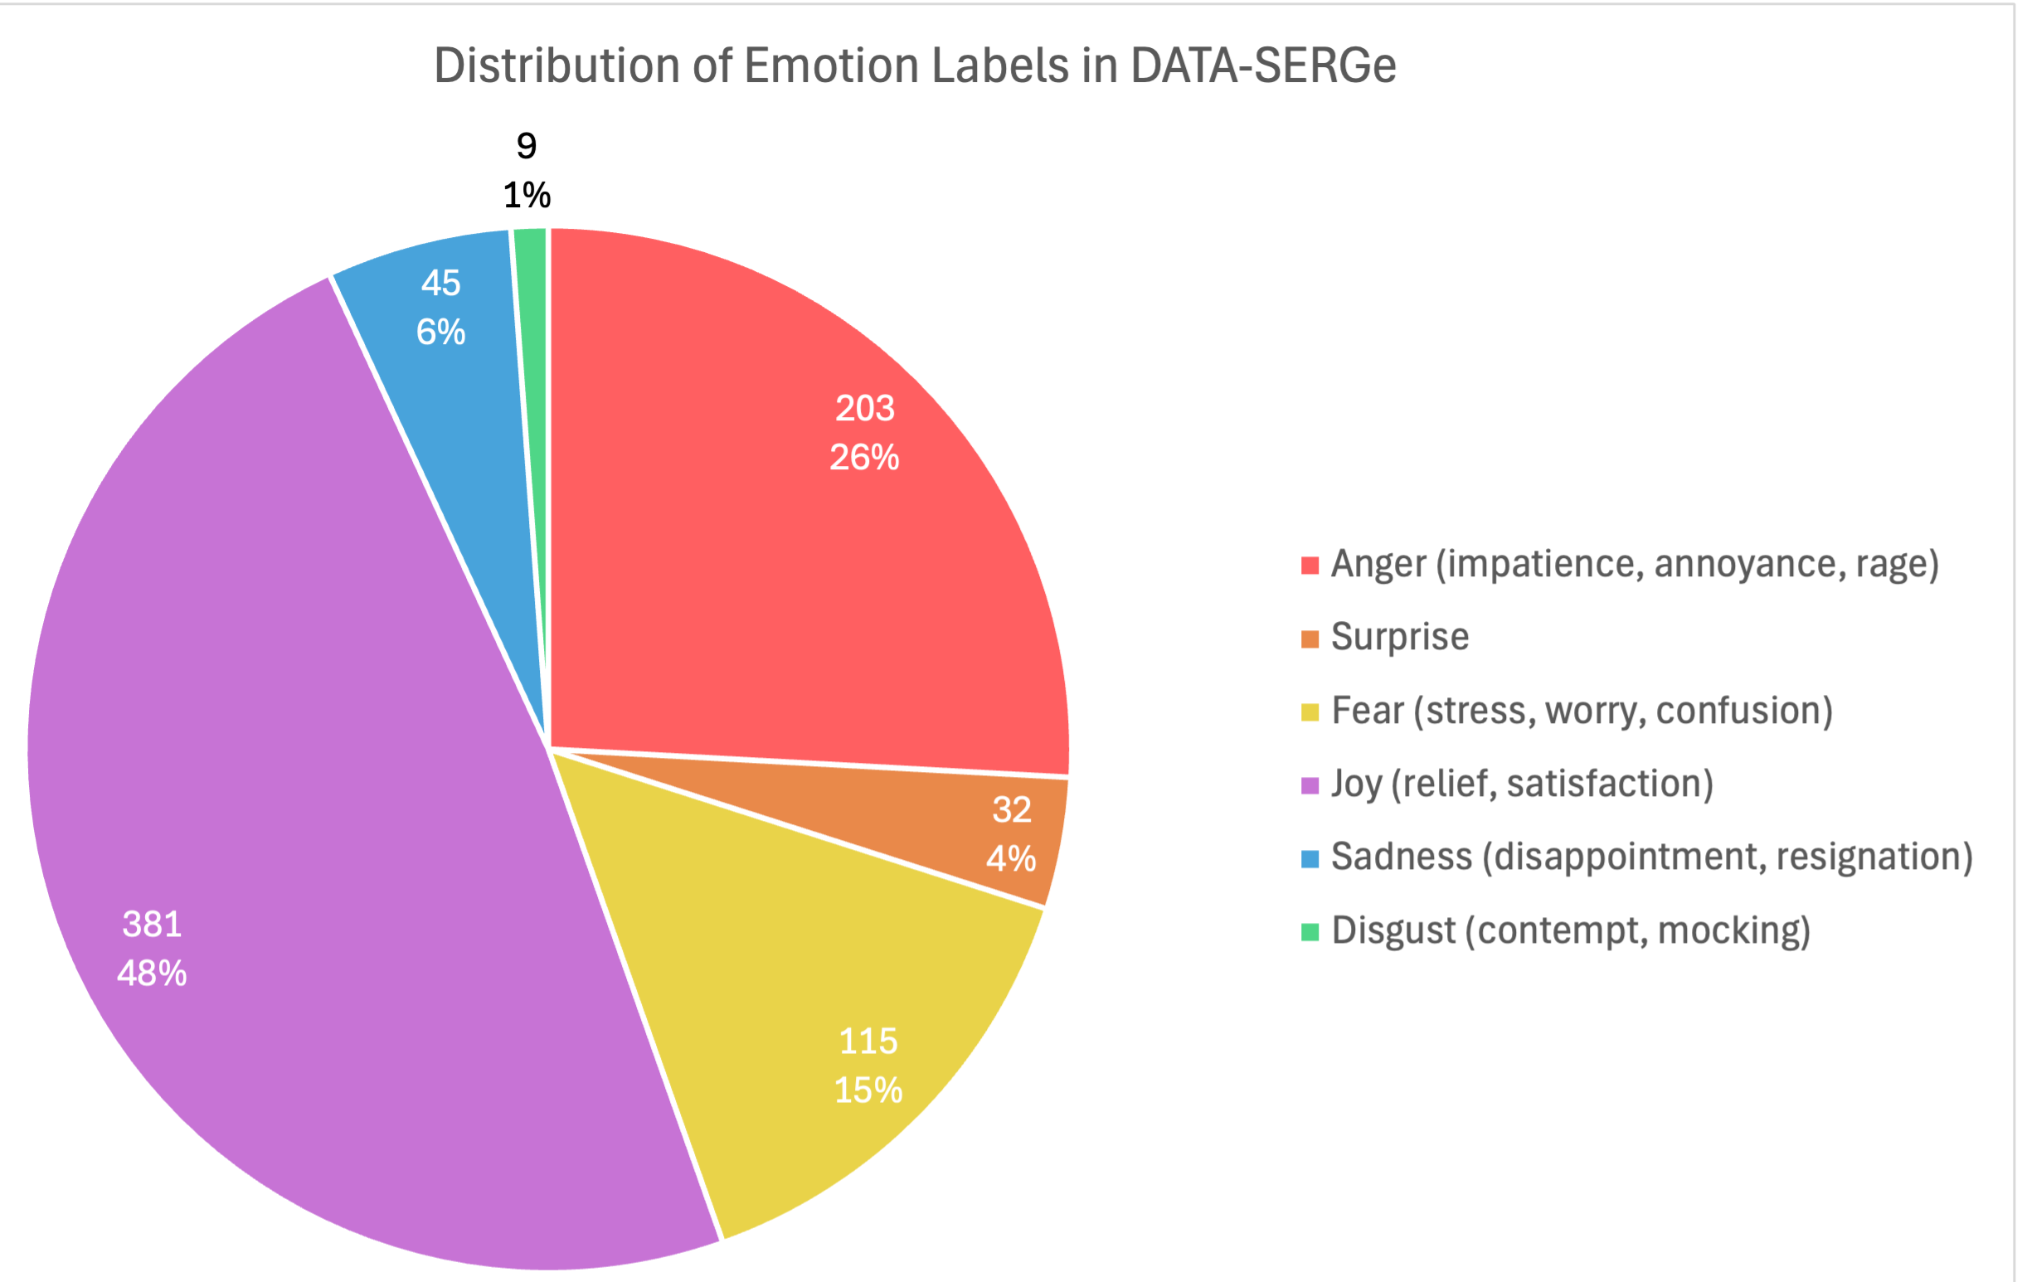
Analysis of DATA-SERGe – Emotion Labels
Notes:
Pour l’annotation au niveau de la conversation, nous avons défini trois aspects qui permettent d’évaluer le ressenti global de la conversation sur plusieurs plans. Ces indices prennent en considération le point de vue du client et la qualité du travail de l’agent. Ils permettent également le filtrage des conversations, car nous souhaitons entraîner nos modèles sur de bons exemples de conversations avec un support agent de bonne qualité pour assurer la satisfaction du client au terme de l’interaction.

Slide 41
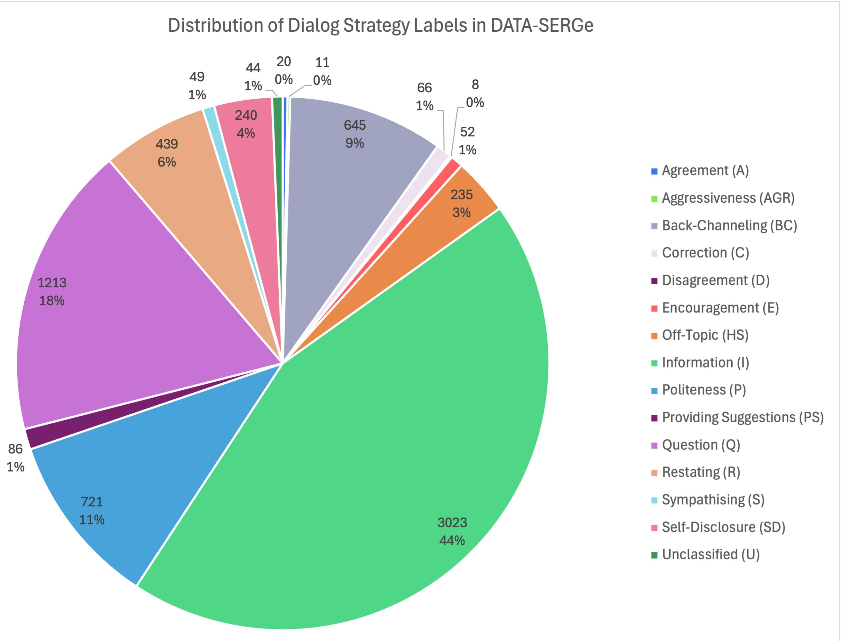
Analysis of DATA-SERGe – Dialogue Strategy Labels
Notes:
Pour l’annotation au niveau de la conversation, nous avons défini trois aspects qui permettent d’évaluer le ressenti global de la conversation sur plusieurs plans. Ces indices prennent en considération le point de vue du client et la qualité du travail de l’agent. Ils permettent également le filtrage des conversations, car nous souhaitons entraîner nos modèles sur de bons exemples de conversations avec un support agent de bonne qualité pour assurer la satisfaction du client au terme de l’interaction.

Slide 42
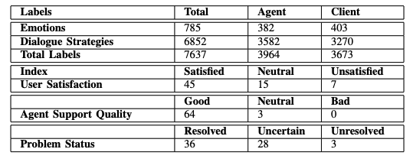
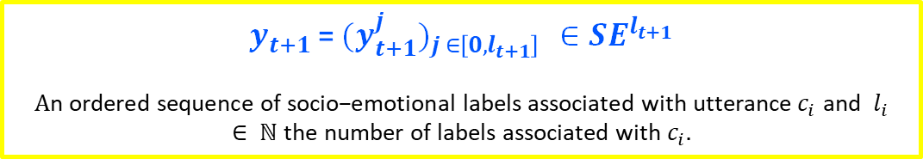

Analysis of DATA-SERGe – Statictics
reminder
$y_{t+1}$= ${{(y}_{t+1}^{j})}_{j ∈\left[0, l_{t+1}\right] }∈{SE}^{l_{t+1}}$
$$A\text{n} \text{ordered} \text{sequence} \text{of} \text{socio}\text{−}\text{emotional} \text{labels} \text{associated} \text{with} \text{utterance} c_{i} \text{and} l_{i}∈ ℕ \text{the} \text{number} \text{of} \text{labels} \text{associated} \text{with} c_{i}.$$
67 conversations 3051 utterances 109 841 tokens
Statistics on $l_{i}$the number of socio-emotional labels associated with the speaker turn $c_{i}$.
Number of labels annotated on utterance and conversation level.

Slide 43
DailyDialog: Description
- Public Dataset in English
Dialogue Acts
- Human-Human conversational data, on daily, common topics.
Inform
Commissive
Question
Directive
- Manually annotated in emotions and dialogue acts.
Emotions
- Average label count per utterance: 1.20
Anger
Disgust
Sadness
- Train / Val / Test split: 11118 / 1000 / 1000 conversations, for over 80k utterances in total.
Happiness
Fear
Surprise
Other
Notes:
Pour l’annotation au niveau de la conversation, nous avons défini trois aspects qui permettent d’évaluer le ressenti global de la conversation sur plusieurs plans. Ces indices prennent en considération le point de vue du client et la qualité du travail de l’agent. Ils permettent également le filtrage des conversations, car nous souhaitons entraîner nos modèles sur de bons exemples de conversations avec un support agent de bonne qualité pour assurer la satisfaction du client au terme de l’interaction.

Slide 44
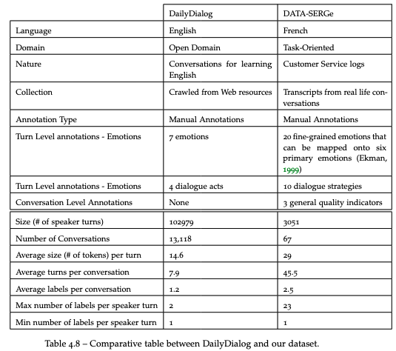
DATA-SERGe vs. DailyDialog
Notes:
Pour l’annotation au niveau de la conversation, nous avons défini trois aspects qui permettent d’évaluer le ressenti global de la conversation sur plusieurs plans. Ces indices prennent en considération le point de vue du client et la qualité du travail de l’agent. Ils permettent également le filtrage des conversations, car nous souhaitons entraîner nos modèles sur de bons exemples de conversations avec un support agent de bonne qualité pour assurer la satisfaction du client au terme de l’interaction.

Slide 45
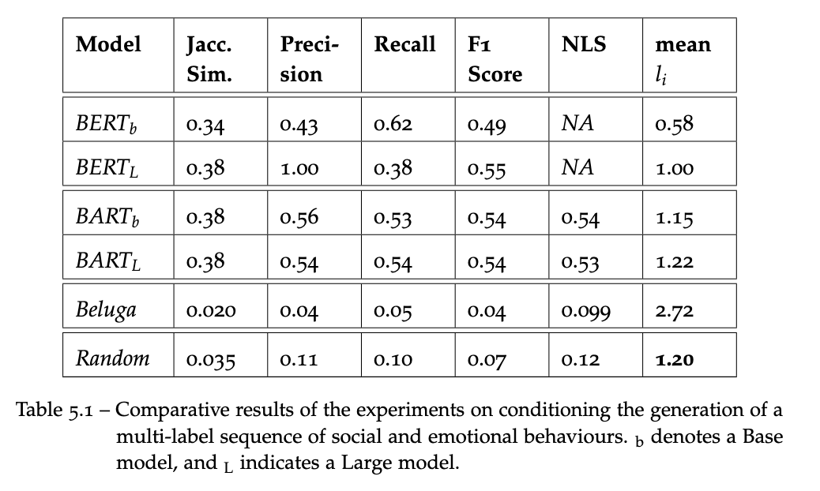
Experiment 1: Planning Module
DailyDialog
MODELS CONSIDERED
BERT – Classifier (small, medium)
BART – Generator (base, Large)
Beluga (Llama-based prompt LLM)
Random baseline

Slide 46
Experiment 1: Generative Module
DailyDialog
NO CONDITIONING (NO-CD)
No conditioning, end-to-end generation based only on dialogue history
MODELS CONSIDERED
GPT-2 (small, medium)
DialoGPT (small, medium)
BART (base, Large)
Beluga (Llama-based prompt LLM):
R: Rerank
P: Prompt
CONDITIONING SCHEMES (CD)
CD-PRED
CD-GT
Conditioned on label sequences predicted by the BART planning module.
Conditioned on ground truth label sequences

Slide 47
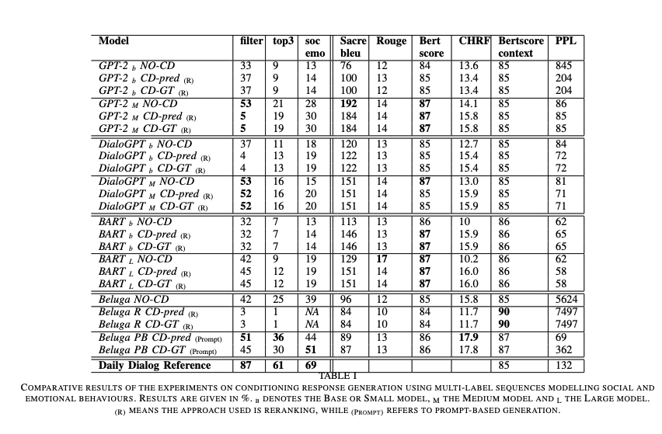
Experiment 1: Generative Module - Results
DailyDialog
CD-PRED
Conditioned on label sequences predicted by the BART planning module.
Human annotated metrics
CD-PRED
Conditioned on ground truth label sequences
Automated metrics
NO-CD
End-to-end generation

Slide 48
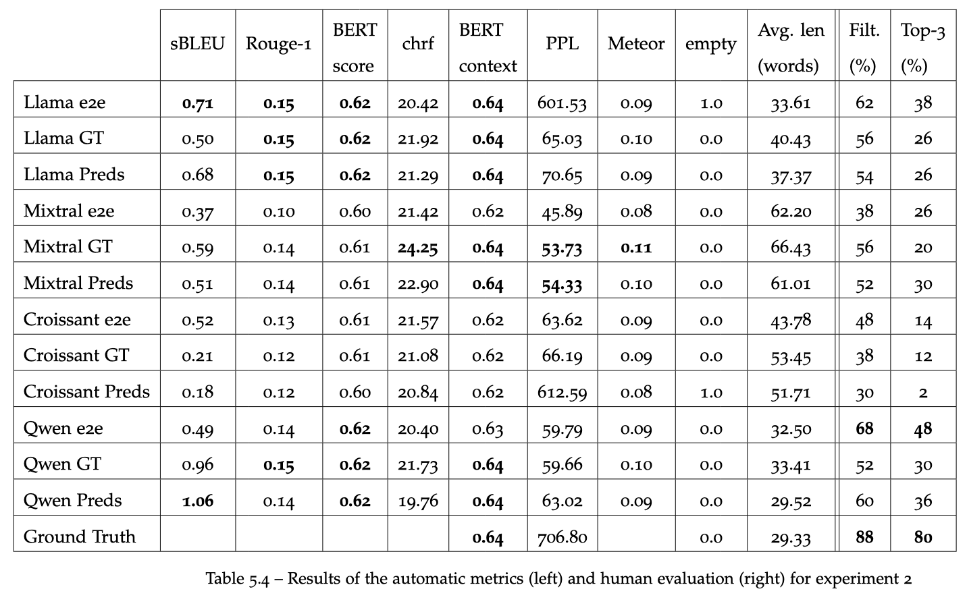
Experiment 2: Results
DATA-SERGe
Human annotated metrics
Automated metrics

Slide 49
Experiment 3: Prompts
End-to-End
Here is an excerpt from a phone call between an auto repair agent and a customer:
[CONTEXT]
From this conversation, generate the agent's next turn. The answer should be short and clear, while maintaining the oral tone of a telephone conversation. The expected format is: AGENT: Response”.
AGENT:

Slide 50
Experiment 3: Prompts – Naïve Planning
Naïve (planning using GT)
Here is an excerpt from a phone call between an auto repair agent and a customer:
[CONTEXT]
From the dialogue extract and the following response plan, generate the agent's answer:
1. Provide information or an objective fact, such as an answer to a question, instructions
2. Ask a question related to the task or conversation in progress to request information
The answer should be short and clear, while maintaining the oral tone of a telephone conversation. The expected format is: AGENT: Response.
AGENT:

Slide 51
Experiment 3: Prompts – 2-Step Planning
2-Step Planning
Here is an excerpt from a phone call between an auto repair agent and a customer:`
[CONTEXT]
From the dialogue excerpt, generate a response plan for the rest of the conversation, taking into account the following sequence of instructions:
1. Provide information or an objective fact, such as an answer to a question, instructions
2. Ask a question related to the task or conversation in progress to request information
For each strategy, suggest a simple action. The response plan should follow the following template: Strategy → Action to take
Here is an excerpt from a phone call between an auto repair agent and a customer:
[CONTEXT]
From the dialogue extract and the following response plan, generate the agent's answer:
1. Action to take 1
2. Action to take 2
The answer should be short and clear, while maintaining the oral tone of a telephone conversation. The expected format is: AGENT: Response.
AGENT:

Slide 52
Experiment 3: Prompts – 3-Step Planning
3-Step Planning
Here is the answer you generated for a phone call between a car repair agent and a customer:
[RESPONSE]
Rewrite the answer concisely. The tone should be adapted to the role of an agent in a telephone conversation. The expected format is: AGENT: Response.
AGENT:
2 steps planning +

Slide 53
Experiment 3: Automatic Evaluation
DATA-SERGe
Notes:
Automatic metrics, like human evaluation, plainly seem to prefer end-to-end and Naive planning, as the other schemes display generally poor results. They are presented in Table \ref{tab:autometric2}. According to automatic metrics, the best-performing systems are Qwen end-to-end and Qwen Naive, which do echo human ratings. However, the trends are different, as automatic results, such as sacreBLEU, ROUGE or the BERTscore, favour end-to-end approaches.
Perplexity results are perplexing, to say the least. The human ground truth has a score of 1357, which is extremely high, and only approached by the multi-step planning schemes. Usually, PPL must be minimised, but in that case, it becomes complicated to compare the scores with a seemingly abnormal ground truth. Other models show more appropriate scores, which shows that the problem does not lie in the code, but elsewhere. Scores such as METEOR or BERT-context show very little variation and do not seem to provide any insight into the quality of the answer.
Semantic and Linguistic diversity both seem to present a slight improvement for all planning schemes compared to end-to-end alternatives. Emotional F1-score, computed by comparing emotions predicted by a camemBERT classifier with the ground truth, also shows a preference for approaches involving planning. As for dialogue strategies, Levenshtein Similarity compares predicted strategies with the ground truth by considering order, clearly prefers end-to-end models, where Jaccard Similarity, which does not take order into account, shows a constant improvement for planning-based schemes over direct generation.
Emotional and Social relevance, represented respectively by Emotion F1-score and Levenshtein and Jaccard Similarity, were based on the output of fine-tuned classifiers that predicted both emotions and sequences of strategies for all generated responses. End-to-end approaches seem to perform a little bit better on these metrics, which contradicts the results of the human evaluation.
To conclude, the best approaches are naive planning and e2e generation. Where some automatic metrics favour the 1-step planning and others prefer end-to-end responses, human evaluation provides higher ratings for naive 1-step planning. In contrast, more complex planning, such as multi-step prompting, performed poorly across all metrics, both human and automatic. While we had hypothesised that letting the model generate a response plan and apply it would make the approach more generalisable, it seems to have failed. We thought that the model would prefer its own explanation and instructions rather than the more general instructions from the naive approach, but it does not seem to be the case. We also noticed that the models did not follow instructions very well, as the 3-Step planning was explicitly asked to provide shorter answers, but on average, they tend to output long responses.

Slide 54
Experiment 3: Metrics Correlations
HUMAN EVALUATION
AUTOMATIC METRICS
PEARSON
LOGICAL
Consistency
BERT_Context (Zhang et al., 2020a)
-0.1
Fluency
PPL (Ni’mah et al., 2023)
0.24
Naturalness
Lexical and Semantic Diversity (Guo et al., 2024)
0.25
EMOTIONAL
Emotion Annotation
Emotion Classifier F1
0.72
SOCIAL
Dialogue Strategy Annotation
Dialogue Strategy classifier Accuracy
0.67

Slide 55
DATA-SERGe: Data Processing
ORIGINAL
PROCESSED
ANONYMISATION
‎ ▇▇ bonjour ▇▇ à votre écoute ?
oui bonjour madame j’ai je j- j’ai un problème avec ma- avec mon assurance
oui d'accord alors euh donnez-moi votre numéro de portable que j'accède au dossier s'il vous plaît
Alors c’est zero- oui zero six
Ah oui parfait ▇▇ c'est madame ▇▇ ▇▇
[COMPANY] bonjour [AGENT NAME] à votre écoute ?
oui bonjour madame j’ai un problème avec ma- avec mon assurance
oui d'accord alors euh donnez-moi votre numéro de portable que j'accède au dossier s'il vous plaît
Alors c’est zero- oui zero six
ah oui parfait [PHONE NUMBER] c'est madame [CUSTOMER NAME]
RépareCar bonjour Nadeige à votre écoute ?
oui bonjour madame j’ai je j- j’ai un problème avec ma- avec mon assurance
oui d'accord alors euh donnez-moi votre numéro de portable que j'accède au dossier s'il vous plaît
Alors c’est zero- oui zero six
Ah oui parfait 01 23 45 67 89 c'est madame Poutch Camille
[COMPANY] bonjour [AGENT NAME] à votre écoute ?
oui bonjour madame j’ai je j- j’ai un problème avec ma- avec mon assurance
oui d'accord alors euh donnez-moi votre numéro de portable que j'accède au dossier s'il vous plaît
Alors c’est zero- oui zero six
Ah oui parfait [PHONE NUMBER] c'est madame [CUSTOMER NAME]
A classification model trained on customer data, is first used to mask confidential data, then corrected by the annotators. Two versions exist:
> Using fictional placeholders
> Using specific masks
CLEANING
While anonymising the data, the annotators are also tasked to adapt the transcriptions to the textual medium. This includes correcting confusing sentences, removing heavy repetitions, and any other typos.
Notes:
Loss of some (but not all) information such as hesitations as a compromise to create a dataset that can be used for both text and oral systems

Slide 56


Data for Socio-Emotional Response Generation How is socio-conversational data currently collected and annotated?
Crowd-Sourcing
= participatory method where a group of people contributes to creating data samples
Web Crawling
= extracting information from online sites such as social media or sources like OpenSubtitles
Conversation Logs
Synthetic Data
= creating a dataset composed entirely of AI-generated samples
using LLMs
Human-Machine: = logs from deployed conversational systems
Human-Human: = conversation logs from call centers…
H-H
Scripted
H-H
Natural
H-M H-H
Natural
M-M
Synthetic

Slide 57


Data for Socio-Emotional Response Generation How is socio-conversational data currently collected and annotated?
For crowd-sourced data:
Emotional prompt or Instruction
Surveys
SPEAKER POINT OF VIEW
For crawled data:
Metadata
For conversation logs:
User Feedback

Slide 58
Generative Module: Approaches
Rerank & Select
Generation of N=10 candidates, then select the candidate that best matches the expected sequence of labels.
Notes:
We also investigate various ways to condition the generation. One first naive way:

Slide 59
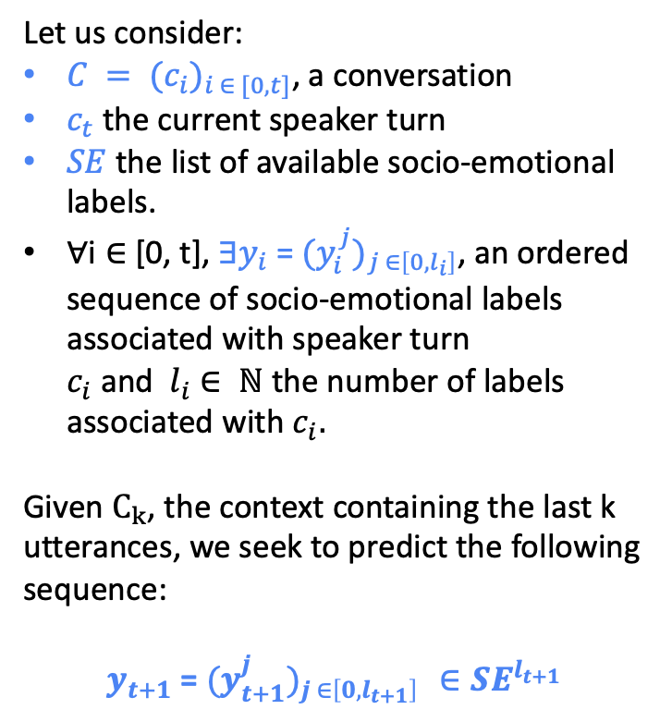
Planning Module: Task Formulation
Context History
Yes. Five pm.
Ok, perfect, thank you.
Let us consider:
$C = {(c_{i})}_{i ∈ [0, t]}$, a conversation
$c_{t}$ the current speaker turn
$SE$ the list of available socio-emotional labels.
$\text{∀}\text{i}∈$[0, t], $∃y_{i}$ = ${{(y}_{i}^{j})}_{j ∈\left[0, l_{i}\right]}$, an ordered sequence of socio-emotional labels associated with speaker turn $c_{i}$ and $l_{i}$ $∈ ℕ$ the number of labels associated with $c_{i}.$
Given $C_{k}$, the context containing the last k utterances, we seek to predict the following sequence:
$y_{t+1}$= ${{(y}_{t+1}^{j})}_{j ∈\left[0, l_{t+1}\right] }∈{SE}^{l_{t+1}}$
[Information, Restating, Information, Joy, Politeness]
Yes, they just told me that they were still working on your vehicle, and that it should be good to go in about an hour and a half.
[Information]
STEP 1: From context history, predict the labels expected in the next response
Right, so I should get there around five pm. Thank you, madam, have a nice day.
[Information, Politeness]
?
Notes:
We consider the task of predicting the sequence $y_{t+1}$of socio-emotional labels related to the next speaker turn $t+1$, $c_{t+1}$.

Slide 60
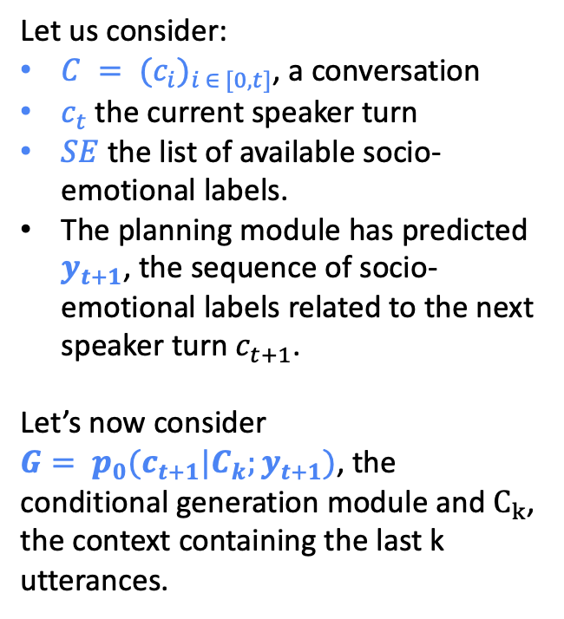
Generative Module: Description
Context History
Let us consider:
$C = {(c_{i})}_{i ∈ [0, t]}$, a conversation
$c_{t}$ the current speaker turn
$SE$ the list of available socio-emotional labels.
$\text{The} \text{planning} \text{module} \text{has} \text{predicted} y_{t+1}$, the sequence of socio-emotional labels related to the next speaker turn $c_{t+1}$.
Let’s now consider $G= p_{0}(c_{t+1}|C_{k};y_{t+1})$, the conditional generation module and $C_{k}$, the context containing the last k utterances.
Yes. Five pm.
Ok, perfect! thank you.
[Information, Restating, Information, Joy, Politeness]
Yes, they just told me that they were still working on your vehicle, and that it should be good to go in about an hour and a half.
“Information”, “Politeness”
?
[Information]
Right, so I should get there around five pm. Thank you, madam, have a nice day.
STEP 2: Using context history and the list of expected labels, generate the response
[Information, Politeness]
?

Slide 61






Data for Socio-Emotional Response Generation How is socio-conversational data currently collected and annotated?
Manual Annotation
Data is entirely annotated by human experts
Automatic annotation
Data is fully annotated by a large language model
OBSERVER POINT OF VIEW
Semi-automatic annotation
Manually annotated data is used to train models to automatically labellize a bigger corpus

Slide 62


Data for Socio-Emotional Response Generation How is socio-conversational data currently collected and annotated?
SPEAKER POINT OF VIEW
OBSERVER POINT OF VIEW
Often Scripted
Third Party Annotation
Reliable annotation of subjective labels
Can be used for any kind of data

Slide 63
Planning
Graph
RL
Heuristics
Fine-tuned
Prompt
GÉNÉRATION
Fine-tuned
Chen et al. (2019a)
Yang, Li, and Quan (2021)
Wang et al. (2020)
Wang, Cheng, and Li (2022)
Yan et al. (2023)
Abulimiti, Clavel, and Cassell (2023)
Yang et al. (2024)
Rashkin et al. (2019)
Zandie and Mahoor (2020)
Altarawneh et al. (2023)
Qian et al. (2023)
Prompt
Sotolar et al. (2024)
Cheng et al. (2022)
Resendiz and Klinger (2023)
Chen et al. (2023)
Li et al. (2024b)
Lee et al. (n.d.)
Zheng et al. (2024)
Kang et al. (2024a)
Zhao et al. (2024b)
Galland, Pelachaud, and Pecune (2022),
Cordier et al. (2022)
He et al. (2024)

